Slide 1
Lecture – 12

Slide 2
Pipeline Processing
Pipelining is a general technique for increasing processor throughput without requiring large amounts of extra hardware.
It is applied to the design of the complex datapath units such as multipliers and floating-point adders.
It is also used to improve the overall throughput of an instruction set processor.

Slide 3
Pipeline Processor
A pipeline processor consists of a sequence of m data- processing circuits, called stages or segments, which collectively perform a single operation on a stream of data operands passing through them.
Some processing take place in each stage, but a final result is obtained only after an operand set has passed through the entire pipeline.

Slide 4
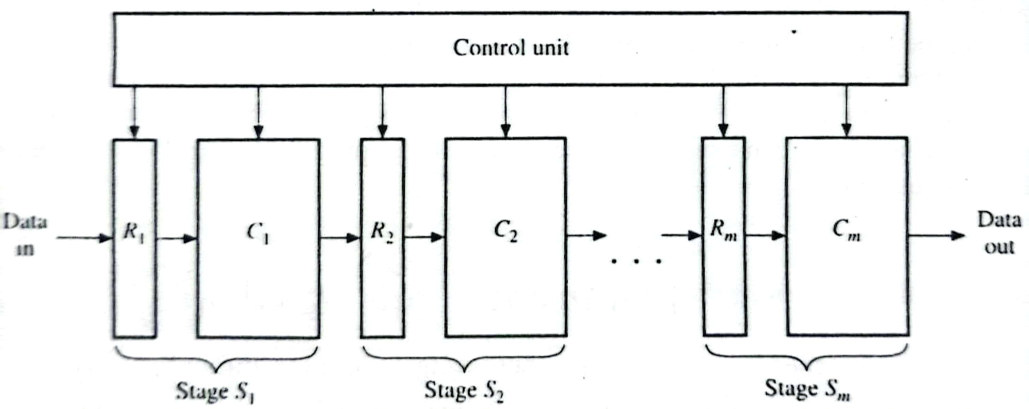
Structure of a Pipeline Processor
S_{i} = Stage, R_{i} = Multiword input register
C_{i} = Datapath Circuit, D_{i-1} = Received by R_{i} from S_{i-1}.
In each clock period, every stage transfers its previous results to the next stage and computes a new set of results.

Slide 5
Advantage of Pipeline Processor
An m-stage pipeline can simultaneously process up to m
independent sets of data operands.
These data sets move through the pipeline stage by stage so that when the pipeline is full, m separate operations are being executed concurrently, each in a different stage.
A new final result emerges from the pipeline every clock cycle.

Slide 6
Pipeline Processor
An m-stage pipeline can simultaneously process up to m independent sets of data operands.
Suppose that each stage of the m stage pipeline takes T seconds to perform its local suboperation and store its results.
Then T is the pipeline’s clock period.
The delay or latency of the pipeline is mT.
The throughput (maximum number of operations completed per second) of the pipeline is 1/T.
The CPI is one.
Any operation that can be decomposed into a sequence of sub-operations of about the same complexity can be realized by a pipeline processor.

Slide 7
Four-stage Floating-point Adder Pipeline
The addition of two normalized floating-point numbers x and y can be implemented by four step sequence:
compare the exponents.
Align the mantissa.
Add the mantissa.
Normalize the result.

Slide 8
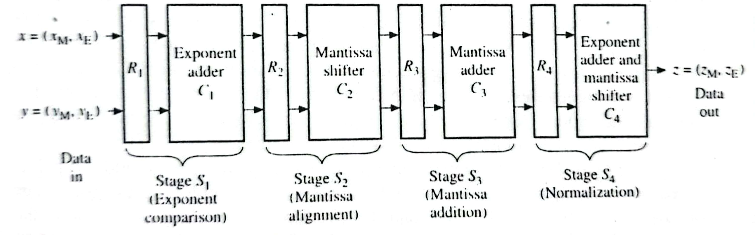
Four-stage Floating-point Adder Pipeline

Slide 9
Four-stage Floating-point Adder Pipeline
It takes 4T time to compute a single sum.
When all the four stages have been filled with data, a new sum can be computed in every T seconds.
So N consecutive additions can be done in (N+3)T
seconds.
So the four-stage pipeline’s speedup is S(4) = 4N / (N+3)
For large N, S(4) ≈ 4.

Slide 10
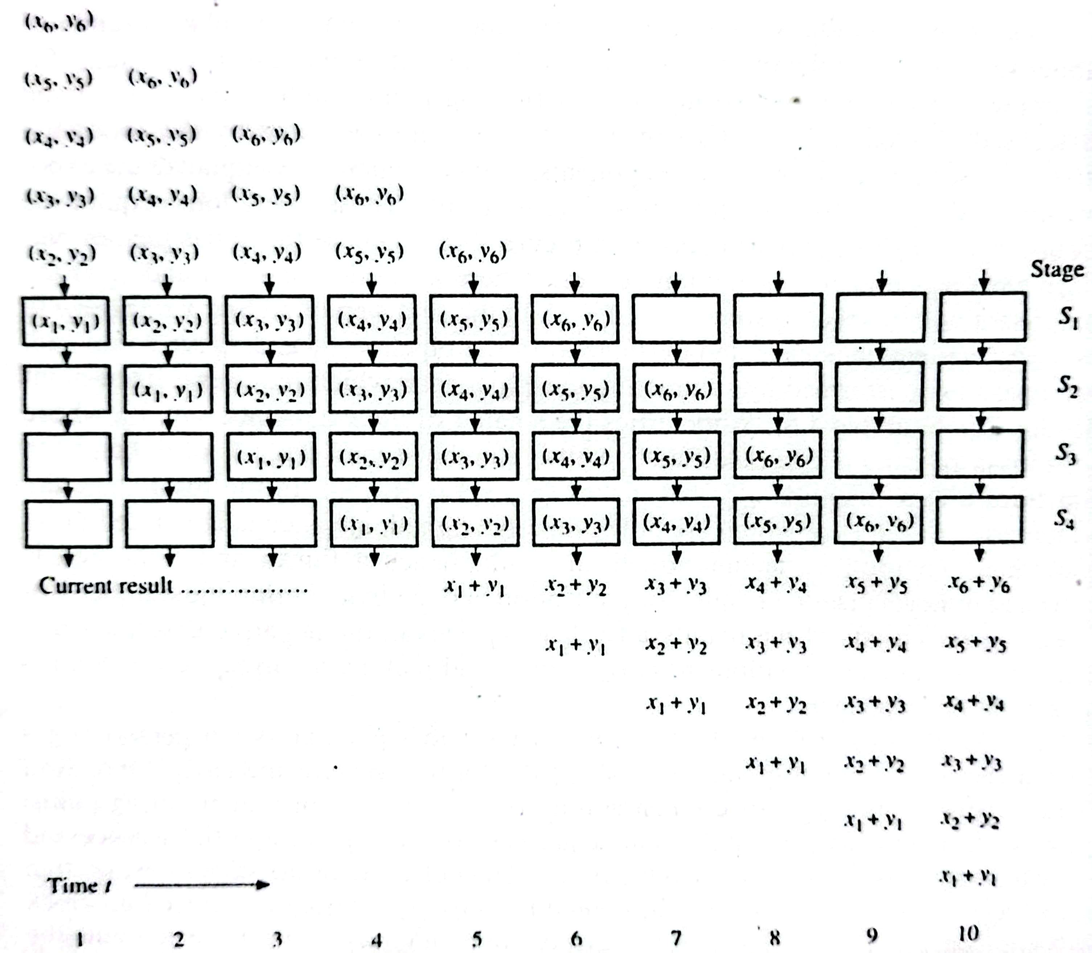
Operations of the Four-stage Floating- point Adder Pipeline

Slide 11
Pipeline Design
Designing a pipelined circuit for a function involves first finding a suitable multistage sequential algorithm to compute the given function.
This algorithm steps should be balanced in the sense that they should all have roughly the same execution time.
Fast buffer registers are placed between the stages to transfer data from stage to stage without interfering with one another.
The buffers are designed to be clocked.

Slide 12
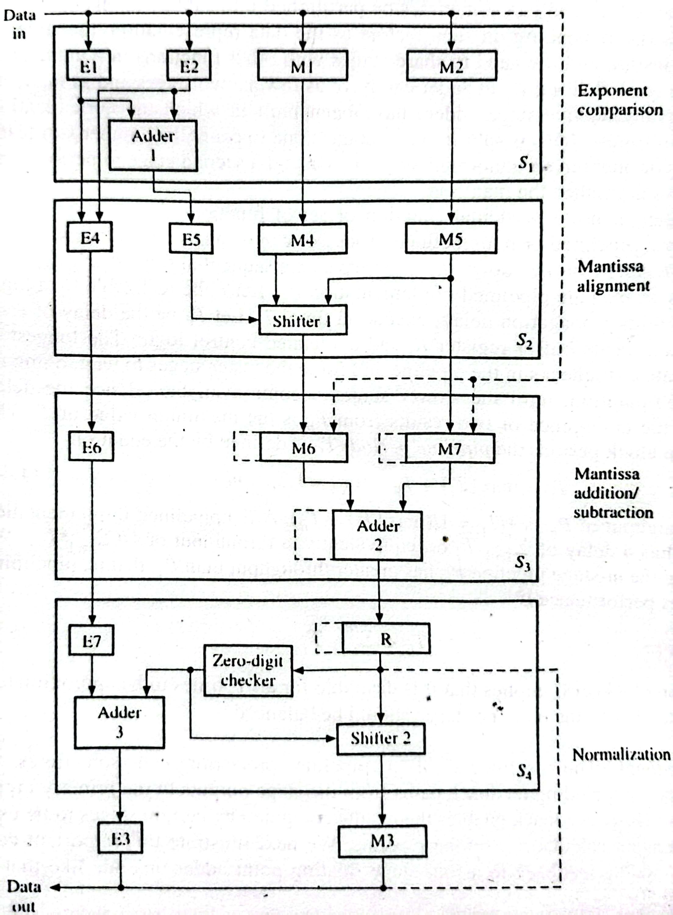
Pipelined Version of the Floating-point Adder

